Slide 1

American Association of
Petroleum Geologists
Distinguished Lecturer
Sponsored by

Slide 2
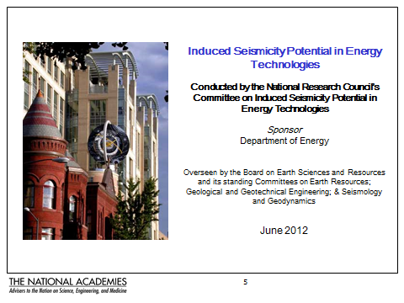

Investigating The Induced Seismicity Potential In Energy Technologies To Understand How To Limit The Occurrence Of Felt Seismicity And Its Impacts
Don Clarke
February 25, 2015

Slide 3
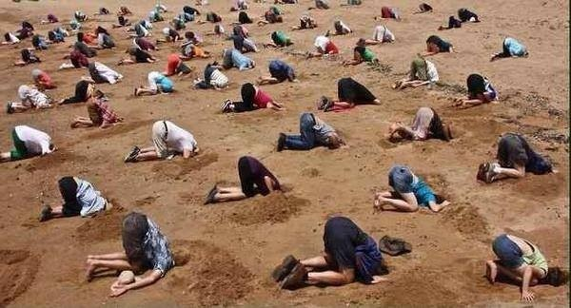
Oklahoma’s New Seismic Monitoring Network

Slide 4
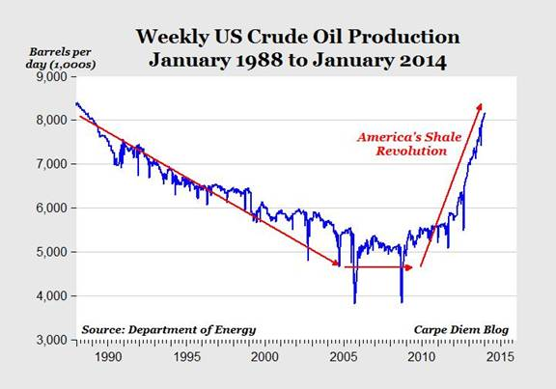

Slide 5
2.4 Million Barrels Per Day Increase in 2 Years!
Put into perspective, that would be like adding the entire daily production of oil in Nigeria (2.4 million bpd in September), and almost as much as adding the entire daily oil production of Mexico (2.56 million bpd) or Kuwait (2.65 million bpd in September) to the US oil supply.
Mark J Perry, Professor of Economics, Flint Campus, University of Michigan

Slide 6
Bakken Shale
October 2014
Has produced over one billion barrels of oil
Produces 1.1 million barrels per day
Oil prices have crashed

Slide 7
This Article in the Long Beach Press Telegram dated September 10, 2013 questions hydraulic fracturing.
Sadly the interviews were with uninformed people from both sides of the argument.

Slide 8
“In Pennsylvania, the closer you live to a well used to hydraulically fracture underground shale for natural gas, the more likely it is that your drinking water is contaminated with methane”. Robert Jackson from Duke University in the Proceedings of the National Academy of Sciences USA, July 2013
Mark Fischetti of Scienticic American, September 2013 points out that Jacksons work does not prove the point but also says that the oil industry’s denials undermine their own credibility.

Slide 9
Some Perspective
Since 1947 over one million wells have been hydraulically fractured.
In California SB-4 has given DOGGR new rules to get in place
Moment magnitude (M) is used for earthquakes. It is the energy released not the amount of shaking.
M -2 =1m² rupture
M 3 = 15 acres rupture
M 4 = ½ mi² rupture with a displacement of 0.4 inches
M 5 = 4.2 square miles rupture with a 1.8 inch displacement
M 8 = a rupture the size of Delaware
All HF combined in California uses 305 Acre-feet of water per year
An average microchip producer uses 1086 Acre-feet of water in one year

Slide 10
Report Overview
Introduction to induced seismicity and its history
Types and causes of induced seismicity
Induced seismicity of energy technologies
  Geothermal
  Oil and gas (including EOR and shale gas recovery)
  Waste water injection
  Carbon capture and sequestration (CCS)
Government roles and responsibilities
Understanding hazard and risk assessment to manage induced seismicity
Steps toward best practices
Findings, gaps, proposed actions, and research recommendations

Slide 11
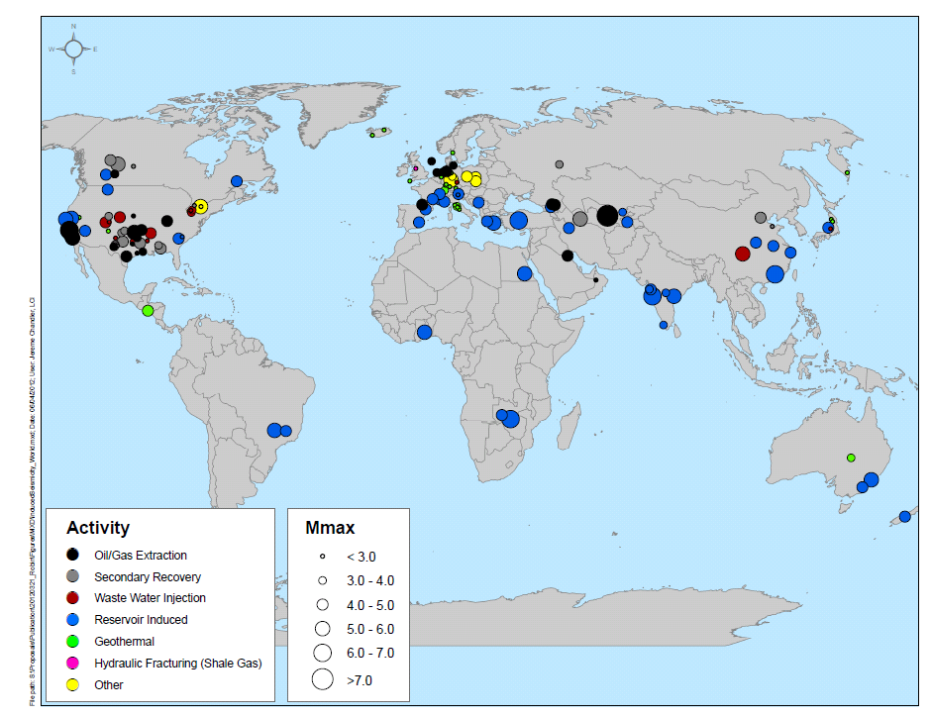
Background
A number of seismic events apparently related to fluid injection for energy development occurred during the past 7 years, for example:
  Basel, Switzerland, 2006,
  Enhanced geothermal system (M 3.4)
  Dallas-Ft. Worth airport area, 2008-09, Waste water disposal from shale gas development (M 3.3)
  Blackpool, England, 2011,
  Hydraulic fracturing (shale gas) (M 2.3)
Public concern about these kinds of events prompted Senator Bingaman to ask Secretary Chu to request a study by the National Research Council on “Induced Seismicity in Energy Technologies”
Notes:
11

Slide 12
Statement of Task
This study will address the potential for felt induced seismicity of geothermal systems, oil and gas production including enhanced oil recovery and hydraulic fracturing for shale gas production, and carbon capture and storage (CCS) and specifically will:
summarize the current state-of-the-art knowledge on the possible scale, scope and consequences of seismicity induced during the injection of fluids related to energy production;
identify gaps in knowledge and the research needed to advance the understanding of induced seismicity, its causes, effects, and associated risks;
identify gaps and deficiencies in current hazard assessment methodologies for induced seismicity and research needed to close those gaps;
identify and assess options for interim steps toward best practices, pending resolution of key outstanding research questions.

Slide 13
Types and Causes of Induced Seismicity
Induced seismic activity has been attributed to a range of human activities including:
  Impoundment of large reservoirs behind dams
  Controlled explosions related to mining or construction
  Underground nuclear tests
  Energy technologies that involve injection or withdrawal of fluids from the subsurface

Slide 14
Types and Causes of Induced Seismicity
in Fluid Injection/Withdrawal for Energy Development
The general mechanisms that create induced seismic events are well understood.
However, we are currently unable to accurately predict the occurrence or magnitude of such events due to the lack of comprehensive data on complex natural rock systems and the lack of validated predictive models.

Slide 15
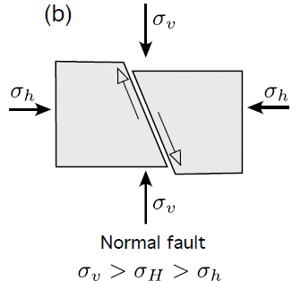
Induced seismicity is caused in most cases by change in pore fluid pressure and/or change in stress in the subsurface in the presence of:
  faults with specific properties and orientations;
  a critical state of stress in the crust.
The factor that appears to have the most direct correlation in regard to induced seismicity is the net fluid balance — the total balance of fluid introduced into or removed from the subsurface.
Additional factors may also influence the way fluids affect the subsurface.
Types and Causes of Induced Seismicity
in Fluid Injection/Withdrawal for Energy Development

Slide 16
Energy Technologies
Geothermal energy development
  Vapor-dominated
  Liquid-dominated
  Enhanced geothermal systems (EGS)
Oil and gas development
  Oil and gas extraction (fluid withdrawal)
  Secondary recovery (waterflooding)
  Tertiary recovery (CO2 flooding)
  Hydraulic fracturing for shale gas
Waste water disposal wells
Carbon capture and storage (CCS)

Slide 17
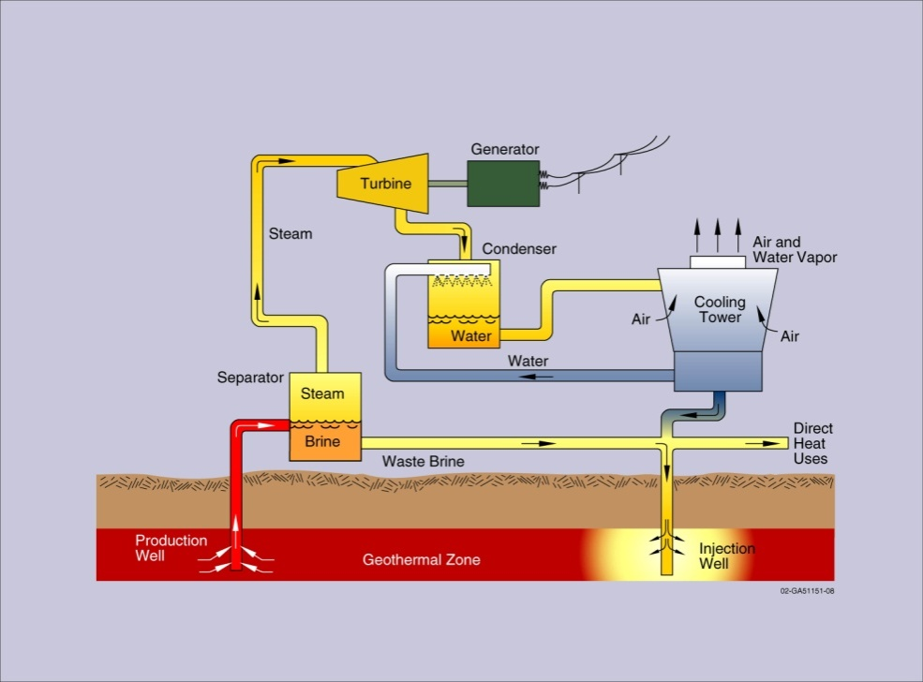
Geothermal Energy
Vapor-dominated—primarily steam in pores and fractures of the rock
Liquid-dominated—primarily hot water in the pores and fractures of the rock
Enhanced geothermal systems (EGS)—“hot dry rock” requires fracturing to promote hot water circulation
Operators attempt to keep balance between fluid volumes produced and fluids replaced by injection to maintain reservoir pressure
Different from other energy technologies in temperature of reservoir
Flash Steam Power Cycle for liquid-dominated systems

Slide 18
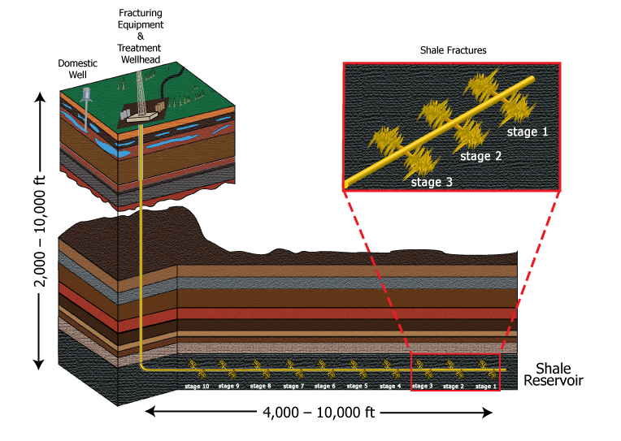
Oil and Gas
Oil and gas withdrawal—removes large volumes of fluids over decades, usually with accompanying fluid injection
Enhanced recovery—inject fluids (water, steam, CO₂, etc.) to extract remaining oil and gas
  secondary recovery (often ‘waterflooding’)
  tertiary recovery (enhanced oil recovery)
Hydraulic fracturing a well for shale gas development—use horizontal drilling and hydraulic fracturing to create fractures for gas to migrate to a well
Oil and gas operators attempt to balance the fluid volumes produced with fluid injection to maintain reservoir pressure
Shale gas development
18

Slide 19
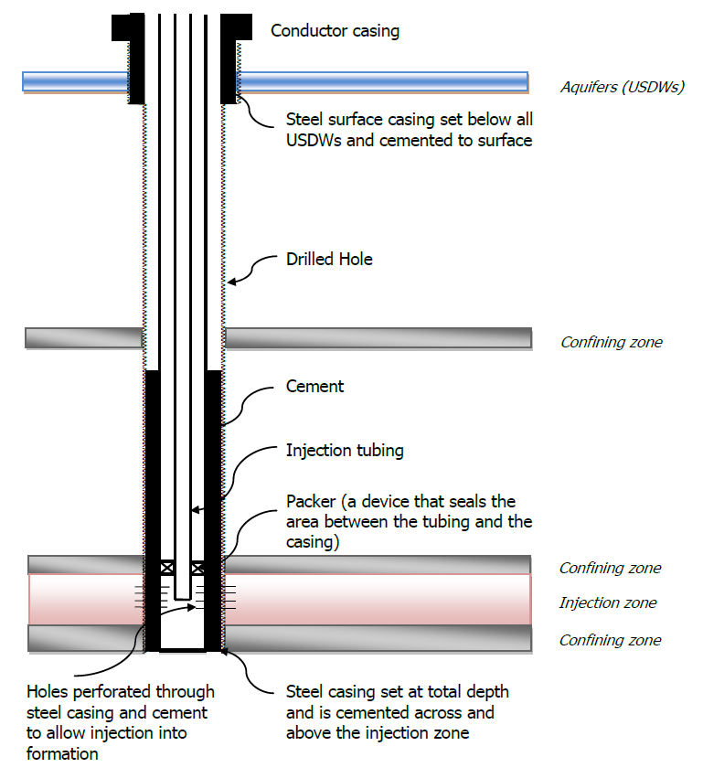
Waste Water Disposal Wells
Fluid from flow back after hydraulic fracturing and waste fluid produced from conventional oil and gas production in the United States = over 800 billion gallons a year
More than one third of the volume is managed through underground injection for permanent disposal in “Class II” wells, permitted by EPA and states with delegated authority
19
19

Slide 20
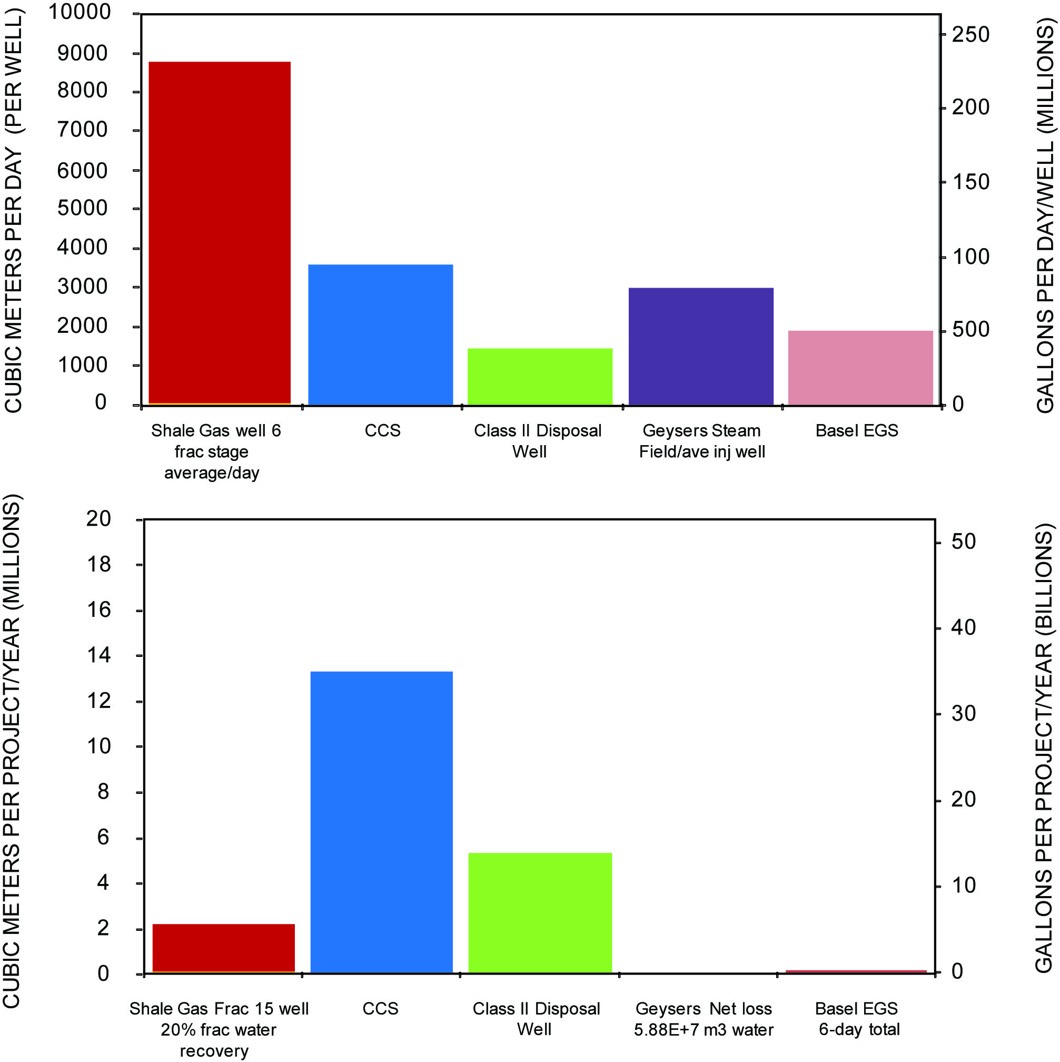
Comparative Estimated Fluid Volumes for Energy Technologies
Shale gas
DAILY
Daily fluid volumes injected are highest for hydraulic fracturing — 8,500 m³
Annual fluid volumes injected are highest for proposed CCS projects (13,000,000 m³) and then Class II waste water disposal wells (4,000,000 m³)
Geysers geothermal field records net fluid loss annually
CCS
Waste
water
ANNUALLY
CCS
Waste
water
Shale gas

Slide 21
Historical Felt Seismic Events Caused by or Likely Related to Energy Technologies in U.S.
Energy Technology | Number of Current Projects | Number of Historical Felt Events | Historical Number of Events M>4.0 | Locations of Events M>2.0
Geothermal
Vapor-dominated (The Geysers) | 1 | 300-400 per year since 2005 | 1 to 3 | CA
Liquid-dominated | 23 | 10-40 per year | Possibly one | CA
EGS | ~8 pilot | 2-10 per year | 0 | CA
Oil and gas
Withdrawal | ~6,000 fields | 20 sites | 5 | CA, IL, NB, OK, TX
Secondary recovery (water flooding) | ~108,000 wells today | 18 sites | 3 | AL, CA, CO, MS, OK, TX
EOR | ~13,000 wells today | None known | None known | None known
Hydraulic fracturing for shale gas recovery | ~35,000 wells today | 1 | 0 | OK
Waste water disposal wells (Class II) | ~30,000 wells today | 8 | 7 | AR, CO, OH,TX
Carbon capture and storage (small scale) | 1 | None known | None known | None known

Slide 22
Geothermal
Induced seismicity appears related to both net fluid balance considerations and temperature changes produced in the subsurface
Different forms of geothermal resource development appear to have differing potential for producing felt seismic events:
  High-pressure hydraulic fracturing undertaken in some geothermal projects (EGS) has caused seismic events that are large enough to be felt
  Temperature changes associated with geothermal development of hydrothermal resources has also induced felt seismicity (The Geysers)

Slide 23
Conventional Oil & Gas Production
Generally, withdrawal associated with conventional oil and gas recovery has not caused significant seismic events, however several major earthquakes have been associated with conventional oil and gas withdrawal.
Relative to the large number of waterflood projects for secondary recovery, the small number of documented instances of felt induced seismicity suggests such projects pose small risk for events that would be of concern to the public.
The committee did not identify any documented, felt induced seismic events associated with EOR (tertiary recovery); the potential for induced seismicity is low.

Slide 24
Unconventional Oil & Gas Production (Shale Gas)
The process of hydraulic fracturing a well as presently implemented for shale gas recovery does not pose a high risk for inducing felt seismic events.
~35,000 wells have been hydraulically fractured for shale gas development to date in the United States.
Only one case of demonstrated induced seismicity from hydraulic fracturing for shale gas has been documented worldwide (Blackpool, England – 2011).

Slide 25
Induced Seismicity Potential —
Energy Waste Water Disposal
The US currently has approximately 30,000 Class II waste water disposal wells (water from energy production). Very few felt induced seismic events reported as either caused by or likely related to these wells. Rare cases of waste water injection have produced seismic events, typically less than M 5.0.
High injection volumes may increase pore pressure and in proximity to existing faults could lead to an induced seismic event.
The area of potential influence from injection wells may extend over several square miles.
Induced seismicity may continue for months to years after injection ceases.
Evaluating the potential for induced seismicity in the location and design of injection wells is difficult because there are no cost-effective ways to locate faults and measure in situ stress.

Slide 26
Induced Seismicity Potential —
Carbon Capture and Sequestration (CCS)
The only long-term (~15 years) commercial CO₂ sequestration project in the world at the Sleipner field offshore Norway is small scale relative to commercial projects proposed in the US. Extensive seismic monitoring has not indicated any significant induced seismicity.
There is no experience with the proposed injection volumes of liquid CO₂ in large-scale sequestration projects (> 1 million metric tonnes per year). If the reservoirs behave in a similar manner to oil and gas fields, these large volumes have the potential to increase the pore pressure over large areas and may have the potential to cause significant seismic events.
CO₂ has the potential to react with the host/adjacent rock and cause mineral precipitation or dissolution. The effects of these reactions on potential seismic events are not understood.

Slide 27
Potential for Induced Seismicity
Summary Points
The factors important for understanding the potential to generate felt seismic events are complex and interrelated and include:
  the rate of injection or extraction
  volume and temperature of injected or extracted fluids
  pore pressure
  permeability of the relevant geologic layers
  faults, fault properties, fault location
  crustal stress conditions
  the distance from the injection point
  the length of time over which injection and/or withdrawal takes place

Slide 28
Understanding Hazard and Risk to Manage Induced Seismicity — Proposed Actions
1. A detailed methodology should be developed for quantitative, probabilistic hazard assessments of induced seismicity risk. The goals in developing the methodology would be to:
  make assessments before operations begin in areas with a known history of felt seismicity
  update assessments in response to observed induced seismicity
Data related to fluid injection (well locations coordinates, injection depths, injection volumes and pressures, time frames) should be collected by state and federal regulatory authorities in a common format and made accessible to the public (through a coordinating body such as the USGS).
3. In areas of high-density of structures and population, regulatory agencies should consider requiring that data to facilitate fault identification for hazard and risk analysis be collected and analyzed before energy operations are initiated.

Slide 29
Government Roles and Responsibilities (Findings)
Responsibility for oversight of activities that can cause induced seismicity is dispersed among a number of federal and state agencies.
Recent, potentially induced seismic events in the US have been addressed in a variety of manners involving local, state, federal agencies, and research institutions. These agencies and research institutions may not have resources to address unexpected events; more events could stress this ad hoc system.
Currently the EPA has primary regulatory responsibility for fluid injection under the Safe Drinking Water Act; this act does not address induced seismicity.
The USGS has the capability and expertise to address monitoring and research associated with induced seismic events. However, their mission does not focus on induced events. Significant new resources would be required if their mission is expanded to include comprehensive monitoring and research on induced seismicity.

Slide 30
Potential for Induced Seismicity
Summary Points Continued
The net fluid balance (total balance of fluid introduced and removed) appears to have the most direct consequence on changing pore pressure in the subsurface over time.
Energy technology projects designed to maintain a balance between the amount of fluid being injected and the amount of fluid being withdrawn, such as geothermal and most oil and gas development, may produce fewer induced seismic events than technologies that do not maintain fluid balance.

Slide 31
Steps Toward Best Practices
(Findings & Gap)
Findings
The DOE Protocol for EGS provides a reasonable initial model for dealing with induced seismicity that can serve as a template for other energy technologies.
Based on this model, two matrix-style protocols illustrate the manner in which activities can ideally be undertaken concurrently (rather than only sequentially), while also illustrating how these activities should be adjusted as a project progresses from early planning through operations to completion.
Gap
No best practices protocol for addressing induced seismicity is in place for each of these technologies, with the exception of the EGS protocol. The committee suggests that best practices protocols be adapted and tailored to each technology.

Slide 32
Study Research Recommendations
Collect field and laboratory data on active seismic events possibly caused by energy development and on specific aspects of the rock system at energy development sites (for example, on fault and fracture properties and orientations, crustal stress, injection rates, fluid volumes and pressures).
Develop instrumentation to measure rock and fluid properties before and during energy development projects.
Hazard and risk assessment for individual energy projects.
Develop models, including codes that link geomechanical models with models for reservoir fluid flow and earthquake simulation.
Conduct research on carbon capture and storage, incorporate data from existing sites where carbon dioxide is injected for enhanced oil recovery, and develop models to estimate the potential magnitude of seismic events induced by the large-scale injection of carbon dioxide for storage.

Slide 33
Conclusion
Although induced seismic events have not resulted in loss of life or major damage in the United States, their effects have been felt locally, and they raise some concern about additional seismic activity and its consequences in areas where energy development is ongoing or planned.
Further research is required to better understand and address the potential risks associated with induced seismicity.

Slide 34
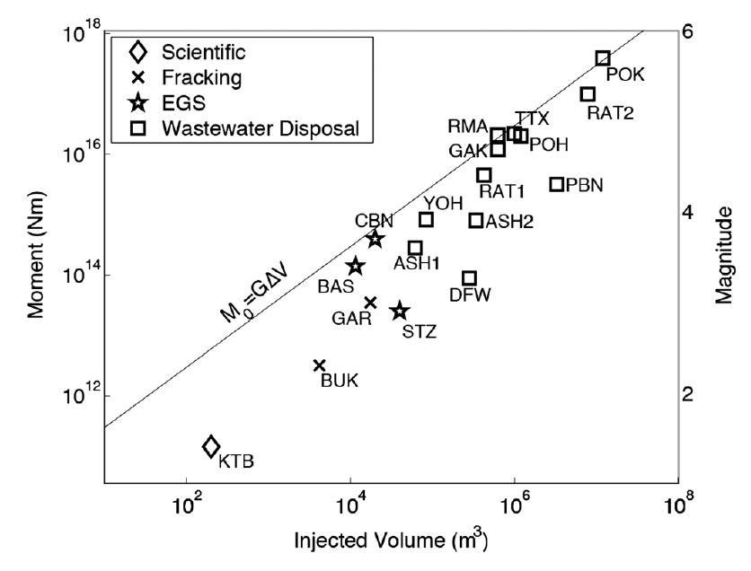
Maximum Seismic Moment and Magnitude
From A. McGarr, 2014

Slide 35
Social License to Operate
The term “Social License to Operate” (SLO) was originally adopted for use by the Canadian mining industry in the late 1990s, and referred to the concept that social permission was needed for a mining company to conduct its operations, for example from local communities or indigenous people. Since then, the premise of the SLO has been extended to other geological challenges faced by society, such as fracking for oil and gas development, radioactive waste disposal, carbon capture and storage, geologic hazards, and deep-well injection of wastewater.

Slide 36
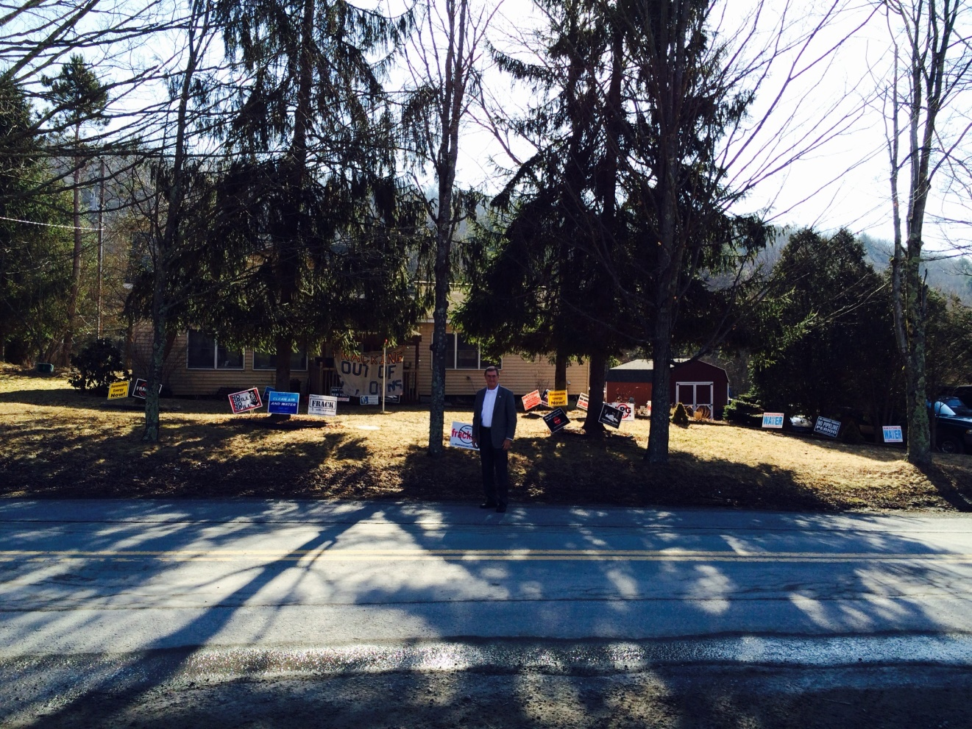
Dimock, PA

Slide 37
Breaking News!!
Youngstown Northstar 1 M-4 on Dec. 31, 2011 Steve Holtcamp
Guy Greenbrier, Arkansas EQ’s in pC basement 1,300 EQ’s 2010-now
Dimock, PA Gasland
Ashtabula, OH Researchers use it as a good example of for and against Induced EQ’s

Slide 38
Hydrofracturing Earthquakes
Horn River Basin, BC Hydrofracturing shale play M3.8 largest Dec. 2013 16 events in 5 days Problem is moving into Alberta

Slide 39
Terry Engelder’s 6 Oil Industry Mistakes
Failure to establish baseline water chemistry prior to drilling
The extent of cementing in casing
Should not have used air-drilling in the vertical legs of the Marcellus gas wells
Should not have lobbied for elements of the Energy Policy Act of 2005 to keep additaves secret

Slide 40
Terry Engelder cont.
Flowback from large hydrofracture was in large enough volumes to induce seismicity
Water management issues associated with potentially leaking pits led to worries of groundwater contaminated

Slide 41
More Breaking News
Central OK EQ Swarm, (Prague M5.6 Nov. 2011) Huge increase in EQ’s starting in 2009 Induced and triggered EQ’s Danielle Sumy
M4 EQ in Cushing, OK, Oct. 2014
Maule EQ may have triggered OK events
Wilzetta Fault increase in Columb stress

Slide 42
Maule Earthquake
The 2010 Chile earthquake occurred off the coast of central Chile on Saturday, 27 February 2010, at 03:34 local time (06:34 UTC), having a magnitude of 8.8 on the moment magnitude scale, with intense shaking lasting for about three minutes. It ranks as the sixth largest earthquake ever to be recorded by a seismograph.

Slide 43
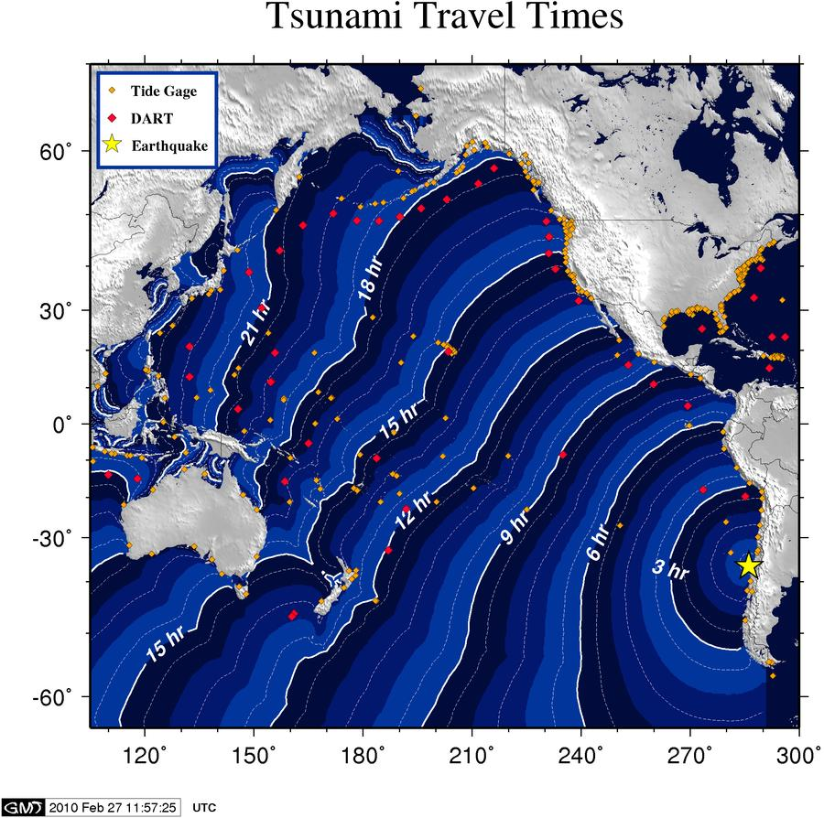
"2010 Chile earthquake NOAA tsunami travel time projection 2010-02-27" by National Oceanic and Atmospheric Administration - http://wcatwc.arh.noaa.gov/2010/02/27/725245/06/ttvu725245-06.jpg. Licensed under Public domain via Wikimedia Commons

Slide 44
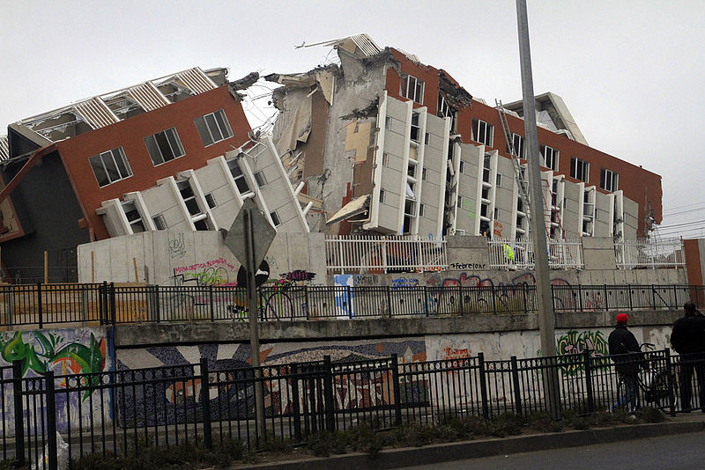
"Chile Earthquake 2010 - Maipú 1" by Jorge Barrios - Own work. Licensed under Creative Commons Attribution-Share Alike 3.0 via Wikimedia Commons

Slide 45
Breaking News California
SB-4 has changed the rules
Beverly Hills officially banned HF
City of Carson has a temporary ban on HF
$3 million awarded to north Texas family that claimed health problems due to HF
AllenCo shut down in Los Angeles because of similar complaints headaches and nose bleeds

Slide 46
International Breaking News
Italian report claims oil activities (500 bopd) may have induced M5.9 &M5.8 EQ’s
Remember the L’Aquila EQ,s 5years ago. The seismologists are in jail (6 years)
French and German HF Bans

Slide 47
Committee membership
Murray W. Hitzman, chair, Colorado School of Mines, Golden
Donald D. Clarke, Geological consultant, Long Beach, CA
Emmanuel Detournay, University of Minnesota, Minneapolis & CSIRO, Australia
James H. Dieterich, University of California, Riverside
David K. Dillon, David K. Dillon, PE, LLC, Centennial, CO
Sidney J. Green, University of Utah, Salt Lake City
Robert M. Habiger, Spectraseis, Denver, CO
Robin K. McGuire, Engineering consultant, Boulder, CO
James K. Mitchell, Virginia Polytechnic Institute and University, Blacksburg
Julie E. Shemeta, MEQ Geo, Inc., Highlands Ranch, CO
John L. (Bill) Smith, Geothermal consultant, Santa Rosa, CA
National Research Council Staff
Elizabeth A. Eide, Study Director
Jason Ortego, Research Associate
Courtney Gibbs, Program Associate
Notes:
47

Slide 48

AAPG Membership Information
Benefits:
…and MUCH more!
Monthly receipt of AAPG Explorer & AAPG Bulletin
Discounts on books and other publications
Registration savings on conferences, exhibitions and educational courses
Services of the AAPG Foundation Energy Resources Library
AAPG Foundation Grants-in-Aid Program
Sponsored Student Memberships
Join at aapg.org

Slide 50
Abstract
In 2010 Senator Bingaman of New Mexico requested that Department of Energy Secretary Steven Chu engage the National Research Council (NRC), the operating arm of the National Academy of Sciences and National Academy of Engineering, to form an ad hoc committee to examine the topic of “Induced Seismicity Potential in Energy Technologies”. The committee of eleven members was formed from a large set of nominees sent to the NRC staff from a spectrum of professionals in academia, government, and industry and was approved by the chair of the NRC. The committee members, each of whom served pro bono for the duration of the project, brought a wide range of expertise to the study including oil and gas exploration and production, geothermal energy, drilling engineering, fluid injection, seismic monitoring and modeling, seismic hazard assessment, geomechanics, mining engineering, fluid-rock interaction, and regulatory oversight, with professional experience derived from academic research, private industry, and government service. During the course of a year, the committee convened five public information-gathering meetings and produced a consensus report that assessed the current situation related to induced seismicity in the United States for various energy technologies including hazards, risks, government roles and responsibilities, proposed research needs and suggestions on how to move forward. The report stands as an example of how a group of objective professionals with varying viewpoints can come to a consensus and produce a useful, scientifically-grounded document to help guide developments with emerging energy technologies.

Slide 51
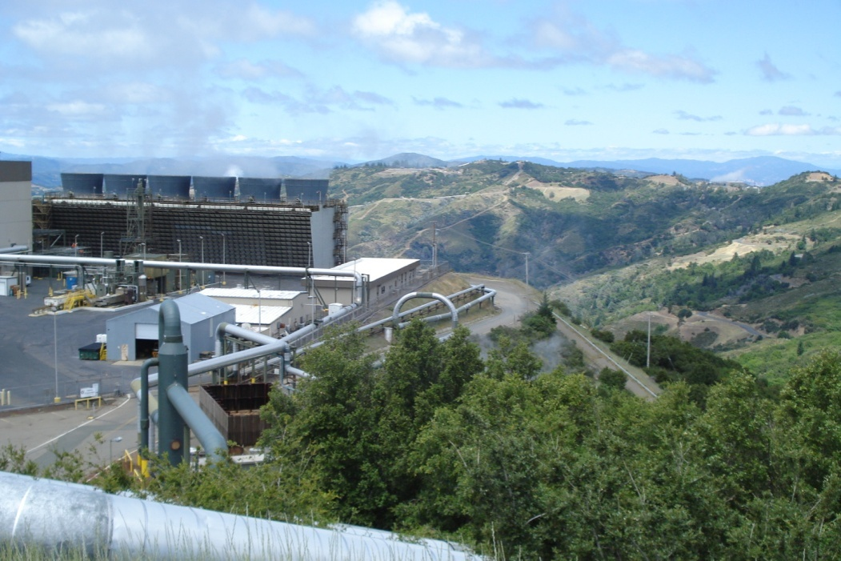
Study Process
Early January 2012
Mid September
Early November
Meeting 6
Writing mtg
Golden, CO
Mid August
Early April
Late April
Mid July
April 2011
June
Printed summer 2013
Meeting 2
Geysers (CA)
Geothermal
Meeting 4
Dallas, TX
Oil and gas, waste water disposal
Meeting 5
Writing mtg
DC
Report to external review
Briefings & public release
June 15
Meeting 1
Washington, DC
Overview
Meeting 3
Irvine, CA
CCS
The Geysers Geothermal Field, July 2011

Slide 52
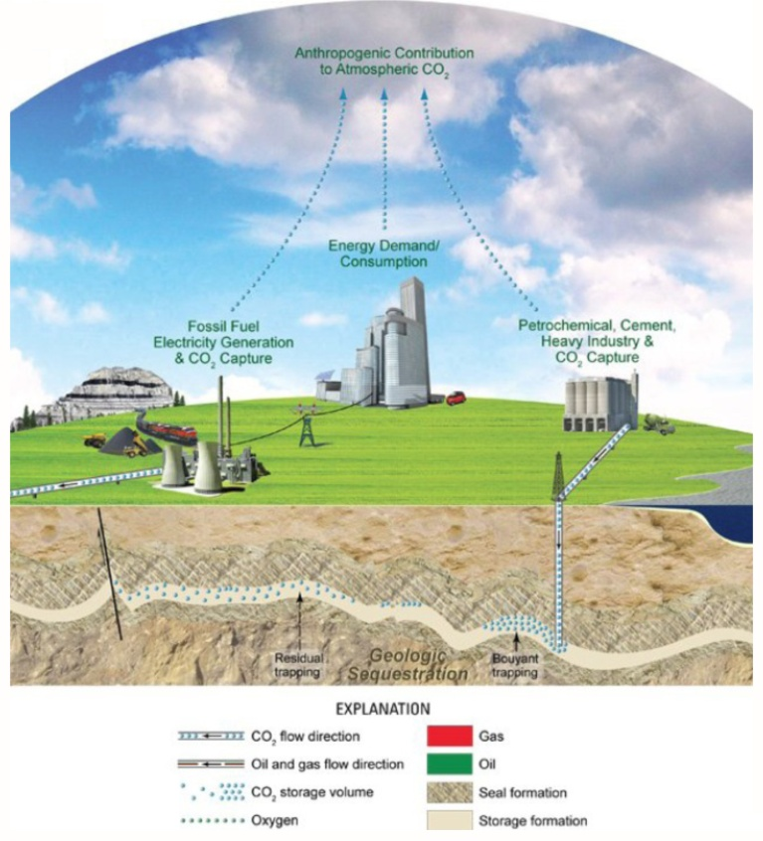
Carbon Capture and Sequestration (CCS)
CO2 can be captured, liquefied, and injected into various kinds of geological formations for permanent storage
CO2 remains a liquid (in “supercritical” phase) underground
Small-scale commercial projects in operation (offshore Norway, onshore Algeria) inject about 1 million metric tonnes of CO2 per year
Regional partnerships in U.S. to test technologies and small-scale injection (Illinois)— plan to inject ~1 million metric tonnes of CO2 per year
Future projects expect to inject much greater than 1 million metric tonnes
52
52
52

Slide 53
Study Findings on Induced Seismicity Potential of Different Energy Technologies
Geothermal
Conventional oil & gas production
Unconventional oil & gas production (shale gas)
Energy waste water disposal
Carbon capture and sequestration

Slide 54
Government Roles and Responsibilities
(Gap & Proposed Actions)
Gap
Mechanisms are lacking for efficient coordination of governmental agency response to induced seismic events.
Proposed Actions
In order to move beyond the current ad hoc approach for responding to induced seismicity, relevant agencies including EPA, USGS, land management agencies, and possibly the Department of Energy, as well as state agencies with authority and relevant expertise, should consider developing coordination mechanisms to address induced seismic events that correlate to established best practices.
2. Appropriating authorities and agencies with potential responsibility for induced seismicity should consider resource allocations for responding to future induced seismic events.

Slide 55
Understanding Hazard and Risk to Manage Induced Seismicity
(Finding)
Currently, methods do not exist to implement assessments of hazards upon which risk assessments depend. The types of information and data required to provide a robust hazard assessment include:
  Net pore pressures, in situ stresses, information on faults
  Background seismicity
  Gross statistics of induced seismicity and fluid injection for the proposed site activity

